Slide 1
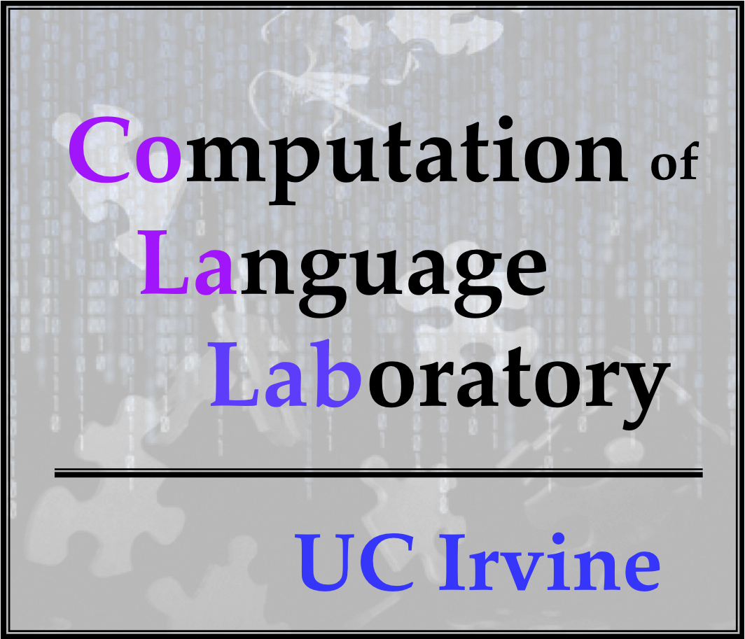



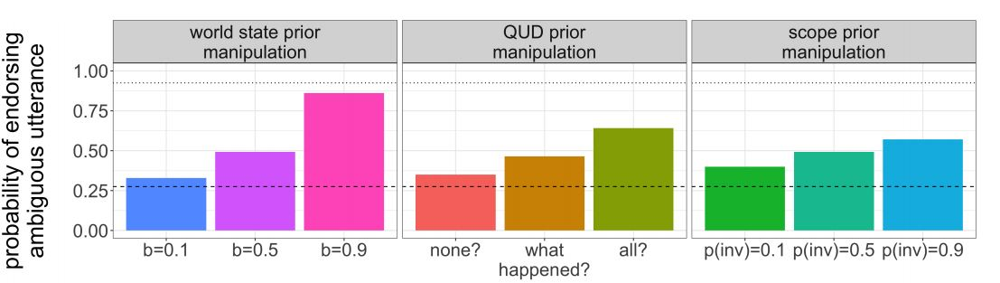



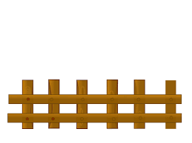



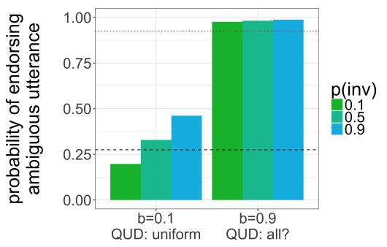
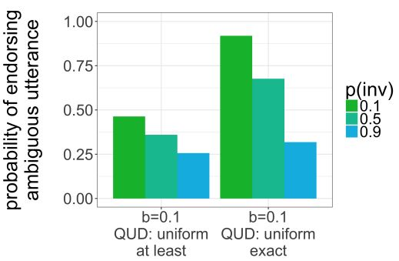
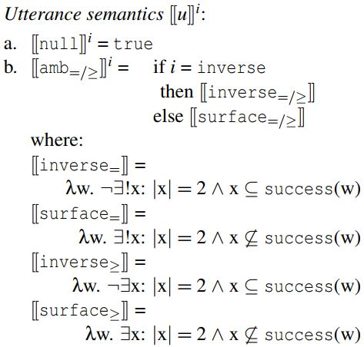
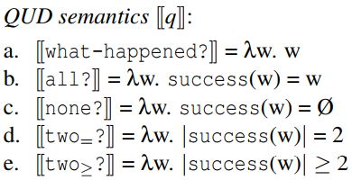




Exactly two things to learn from modeling scope ambiguity resolution:
Developmental continuity and numeral semantics
K.J. Savinelli, Gregory Scontras, and Lisa Pearl
University of California, Irvine
Background
Open Questions
Results
The linguistic phenomenon: scope ambiguity
Developmental continuity: Are child and adult ambiguity behavior in context qualitatively similar? (= same underlying mechanisms)
Why does the explicit contrast clause work for adults with two-not?
What causes the asymmetry in adult behavior across the two contexts?
every-not: Every horse didn’t jump over the fence.
a. ∀ >> ¬ (surface scope):
None of the horses jumped over the fence.
b. ¬ >> ∀ (inverse scope):
Not all of the horses jumped over the fence.
Our contribution
two-not
Adults: 27.5%
Extend model from Savinelli et. al. (2017) to capture adult ambiguity resolution behavior in context.
If the same model can account for children’s behavior in every-not and adult behavior in two-not → developmental continuity.
Replicates previous work modeling children’s behavior with every-not: pragmatic factors impact behavior more than grammatical factor
A truth-value judgment task (TVJT) is used to measure listener endorsement
Which combination of settings capture adult behavior?
2-of-3 context:
surface is false and
inverse is true
The Model
explicit contrast manipulation
asymmetry in 1-of-2 vs. 2-of-4
Adults: Children:
Why do children behave differently than adults?
Interpretations:
i ∊ {surface,inverse}
QUDs:
q ∊ {how-many?,all?,none?,
at-least-two?,exactly-two?}
World states:
w ∊ {0,1,2} and {0,1,2,3,4}
Utterances:
u ∊ {two-not,null}
Savinelli et. al. (2017) articulated a computational model of utterance endorsement that incorporated several pragmatic and grammatical factors.
Used Bayesian Rational Speech Act (RSA) modeling framework (Frank & Goodman, 2012, Goodman & Stuhlmüller, 2013, Goodman & Lassiter, 2015): Language understanding as recursive social reasoning between speakers and ambiguity resolution as pragmatic inference.
Two-not
Adults: 27.5% to 92.5%
Two-not
Adults: 100%
TVJT behavior modeled as utterance endorsement (Degen & Goodman, 2014; Tessler & Goodman, 2016): A pragmatic speaker observes the world state and chooses to utter every-not or nothing at all
Same pragmatic parameter settings (baserate=0.1, no QUD favored) that yielded poor 1-of-2 endorsement yield high 2-of-4 endorsement if inverse scope is hard and use exactly-two semantics.
Pragmatic speaker behavior modeled separately in 1-of-2 vs 2-of-4 contexts.
In the 2-of-4 contexts:
two additional QUD: at-least-two? or exactly-two?
two different interpretations of two: at-least-two semantics vs. exactly-two semantics.
Changing the two pragmatic factors best captures the observed behavior
Baserate of 0.1 to 0.9
No QUD favored to favoring all?
Upshot: Pragmatic factors of world knowledge and beliefs about the question under discussion (QUD) play a stronger role than the grammatical factor of scope when disambiguating every-not.
But adults sometimes behave like children
Discussion
two-not: Two frogs didn’t jump over the rock
a. 2 >> ¬ (surface scope):
Two frogs are such that they didn’t jump.
b. ¬ >> 2 (inverse scope):
It is not the case that two frogs jumped.
Our model of ambiguity resolution in context that previously captured children’s behavior also captures adult behavior: evidence of developmental continuity.
Also explains why the explicit contrast manipulation works: the pragmatic factors create a situation where two-not is still informative despite the ambiguity.
Also supports exactly-two utterance semantics to explain adult asymmetry in endorsement behavior across contexts.
Default Values:
P(w) = baserate = 0.5
P(q) = uniform
P(surface) = 0.5
P(inverse)=0.5
Manipulated values:
P(w) = baserate range 0.1 – 0.9 by 0.4
P(q=favored) = 0.9
Musolino & Lidz 2003
Adults
Underscores the complexity of the disambiguation
Confluence of factors contributes to how these ambiguities are resolved
Pragmatics seems to matter more, but scope is still matters (especially for adult behavior)
2-of-4 context:
surface is true and
inverse is false
1-of-2 context:
surface is false and
inverse is true
two-not
100% endorsement
two-not
27.5% endorsement
Computational modeling can help us refine our theories about language representation
Here: We can manipulate the semantics of two in ways behavioral experiments can’t
Two matters!
explicit contrast +
two-not
92.5% endorsement
References: Leon Bergen, Noah Goodman, and Roger Levy. 2012. That’s what she (could have) said: How alternative utterances affect language use. In Proceedings of the Cognitive Science Society. volume 34, pages 120– 125. Judith Degen and Noah D Goodman. 2014. Lost your marbles? the puzzle of dependent measures in experimental pragmatics. In Proceedings of the Annual Meeting of the Cognitive Science Society. volume 36, pages 397–402. Frank, M. C., & Goodman, N. D. (2012). Predicting pragmatic reasoning in language games. Science, 336(6084), 998–998. Noah D Goodman and Michael C Frank. 2016. Pragmatic language interpretation as probabilistic inference. Trends in Cognitive Sciences 20(11):818–829. Daniel Lassiter and Noah D. Goodman. 2013. Context, scale structure, and statistics in the interpretation of positive-form adjectives. In Semantics and Linguistic Theory (SALT) 23. pages 587–610. K.J. Savinelli, Gregory Scontras, and Lisa Pearl. 2017. Modeling scope ambiguity resolution as pragmatic inference: Formalizing differences in child and adult behavior. In Proceedings of the Annual Meeting of the Cognitive Science Society. volume 39, pages 3064–3069. Michael Henry Tessler and Noah D. Goodman. 2016. A pragmatic theory of generic language.
Two frogs jumped over the fence, but…

